Slide 1
Cosmic Learning: Classifying Stars, Quasars, and Galaxies
Team Members: Ahmad Allaou, Daelyn Bergsman, Spencer Morris
DATASCI 207 Section 007
14 December 2023
Notes:
Hi everyone.
Ahmad, Daelyn, and I are going to be talking to you today about Cosmic Learning: Classifying Stars, Quasars, and Galaxies

Slide 2
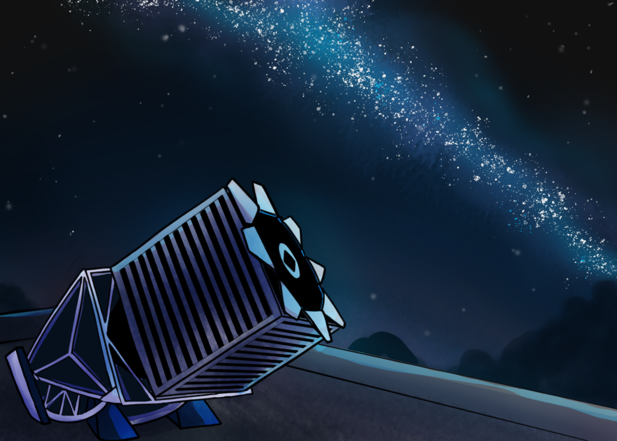
Motivation & Background
Astronomical surveys are huge
Vera C. Rubin Observatory will generate 5 PB of post-processed data per year
Next-gen observatories require automated object classification
Quasars, Galaxies, Nebulae, Stars, Asteroids, Satellites,
… and many others!
ML models can be trained from curated labeled datasets
Sloan Digital Sky Survey (SDSS)
Galaxy Zoo 2 (GZ2)
Notes:
Astronomical datasets are already huge! And the next-gen observatories will be even bigger.
For example, one of them is expected to produce 5 PB of data each year.
What are these observatories doing? They’re looking at objects like stars and galaxies in the night sky, but since there are so many of them they need to be quickly classified in an automated way due to memory limitations. So ML models can play a key role for these data processing pipelines.
And we can use existing datasets to enable ML model development. For example, the Sloan Digital Sky Survey (SDSS) has been running for 20+ years and has a huge repository of data we can leverage for training.

Slide 3
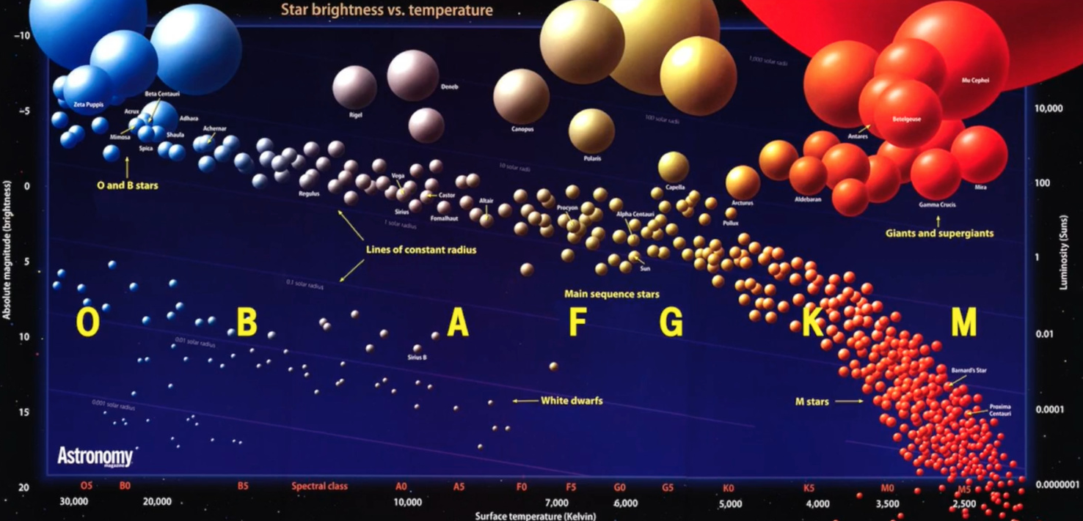
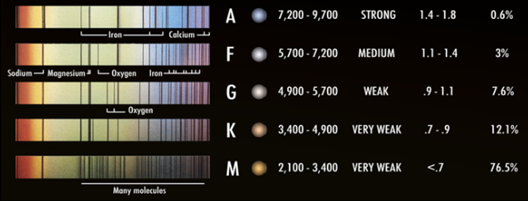
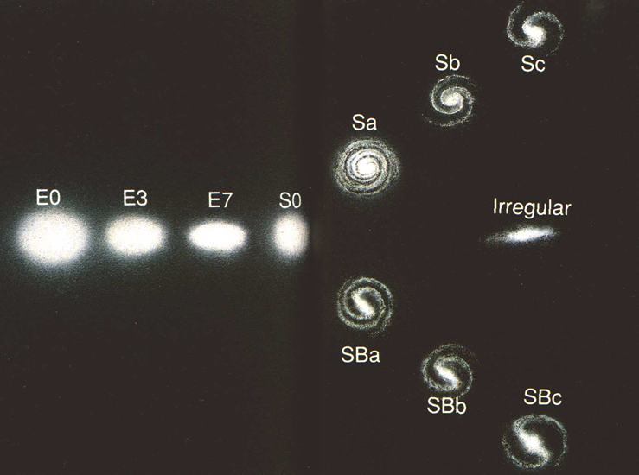
Classification Schema
Superclass
Stars
Galaxies
Quasars
Stars
Subclassified according to MK system (based on spectroscopic color)
Galaxies
Subclassified according to Hubble system (based on geometric morphology)
Notes:
For our project, we restricted ourselves to classifying if an object is a star, galaxy, or quasar, which we call its Superclass. And we were also interested in determining the subclassifications for Stars and Galaxies – so for our project we actually looked at 3 different Classification Tasks.
For the second task, it’s well-known that most stars grow and die according the HZ diagram shown at the upper-right, where they range from big and blue to small and red. And it turns out they can be pretty neatly sorted according to their color – their so-called MK classification.
Galaxies also come in various shapes that are subclassified according to the Hubble system in the lower-right. For example, our own Milky Way is a Spiral Galaxy, but they can have bars, different numbers of arms, or even more of a spheroidal shape.
NOTE: some types are very common, some are very rare! The universe doesn’t produce a balanced dataset.

Slide 4
Datasets
Provenance ensured by directly accessing/querying from original repositories
SDSS
Data coming from many sensors
Included ~2 million unique objects
Tabular (0-d shape)
Labels:
Superclass
Stellar subclass
Galaxy subclass
Features
Photometric (eg. 5 color channels)
Spectroscopic (eg. redshift)
GZ2
Labeling citizen-science project
Included ~few hundred thousand unique objects
Images (3-d shape, 424x424 pixels)
Labels:
Galaxy subclass
Features:
Photometric (3 color channels)
Geometric
Notes:
We wanted to ensure the data were as accurate as possible, so we opted to forgo collecting data from Kaggle and went straight to the primary sources.
Our first dataset is from the SDSS observatory itself, where data is coming from many sensors.
<Summarize details>
Our second dataset is from Galaxy Zoo 2, which was a project that enabled hundreds of thousands of citizen-scientists to manually label the shapes of galaxies based on their images.
<Summarize details>

Slide 5
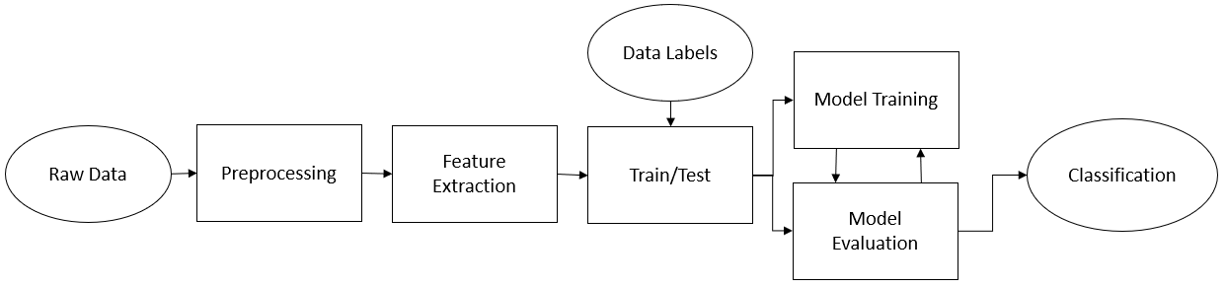
Modeling Block Diagram
Notes:
And this is a high-level depiction of our approach. We preprocessed the data, did extensive label and feature engineering, then split it into subsets so that we could train and evaluate classification performance. And along the way we continuously did EDA and a bunch of experiments to tune the models.
And with that, I’m going to hand it off to to Ahmad

Slide 6
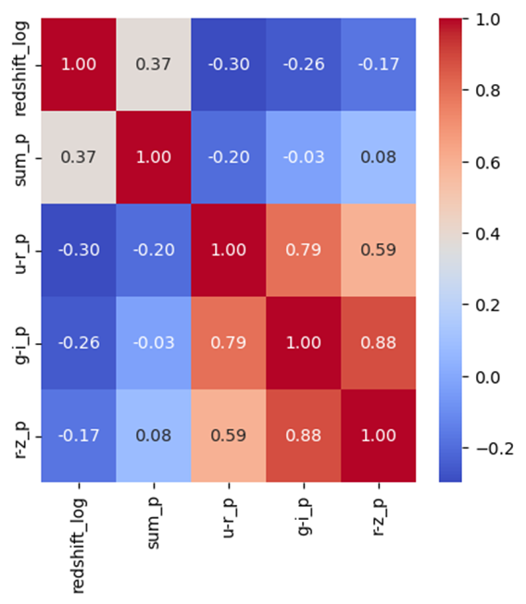
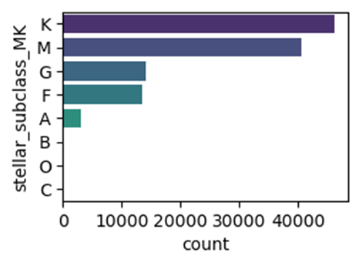
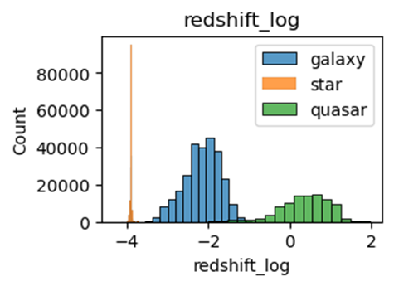
Tabular preprocessing
Label engineering
Stars: 171 → 10
Galaxies: 818 → 14
Feature engineering
Derived features
Transformations
2 feature-sets (n=5, n=8)
Filtering
Brightness (p_r < 17 maggies)
Angular size (R_r > 17 arcsec)
Notes:
We started with some tabular preprocessing based on some of the literature.
The original dataset included subsets of subclassifications for stars and galaxies, so we engineered them to smaller sets (171 star labels down to 10, and 818 galaxy labels down to 14) based on the Simplified HZ and Hubble schemas we covered earlier. As seen at upper right, even still, the dataset was hugely imbalance – you can see small K-type stars are much more common than the massive and rare O-type stars.
Furthermore, feature engineering was done to compress more than 20 features down to something more interpretable. In the end, we had 5 features <read from matrix>.
To get there, we derived new photometric features. We also did transformations including z-standardization and log transforms. You can see at the bottom-right that a histogram of the log of redshift is already almost a perfect discriminant for superclass. And this is what we expected to some extent, since redshift is a measure of the distance to the object, which can easily tell us the superclass.

Slide 7
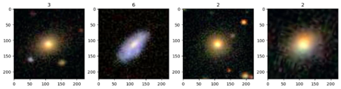
Image Preprocessing
Images loaded, and resized from 424x424 to 224x224 to maintain consistency and for ResNet requirements
Adjustments were made to the brightness and contrast of the images
Randomly shuffled, split into training, validation, and test sets (60-20-20)
Scaled RGB values from 0-255 to [0,1]
Example of images after preprocessing:

Slide 8
Models
Model | Superclass | Stars | Galaxies | Dataset
PCA | x | x | x | tabular
Linear Regression |  | x |  | tabular
K-means | x | x | x | tabular
KNN | x | x | x | tabular
Logistic Regression | x | x | x | tabular
SVM | x | x | x | tabular
Decision Tree | x | x | x | tabular
Random Forest | x | x | x | tabular
Feedforward NN | x | x | x | both
Res-Net |  |  | x | imagery
CNN |  |  | x | imagery
LSTM |  |  | x | imagery
Notes:
This is just a summary of all the models we tried.
In the end, we tried 12 models, applied to 3 classification tasks, using 2 datasets. We tried clustering, linear regression, and a lot of classification models.

Slide 9
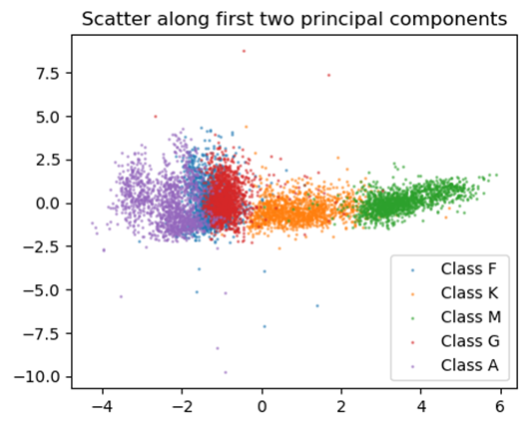
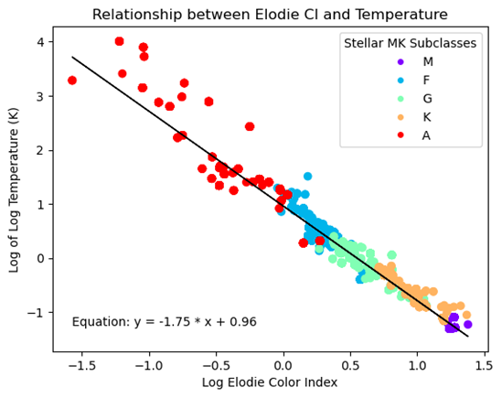
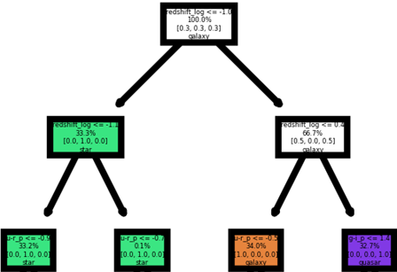
Some notable findings for superclass and stars…
Decision Tree (superclass)
Redshift is largely explanatory
PCA (stellar)
2 PC’s explain ~85% of variation
Linear regression (stellar)
Temperature is predictive of Elodie Color Index (R2~0.98)
Notes:
Although galaxy classification was our primary interest, we tried a lot of other stuff too.
For superclass, we used a decision tree to prove to ourselves that redshift was basically a perfect discriminant.
When we did a PCA for the star data, we found that 85% of the variation of the 8 features could be explained by 2 PC’s. The scatterplot of the PC’s shows structure that is very similar to the famous HZ diagram of stellar evolution.
Finally from our linear regression model for stars, we found that a star’s color index is well-explained by its temperature

Slide 10
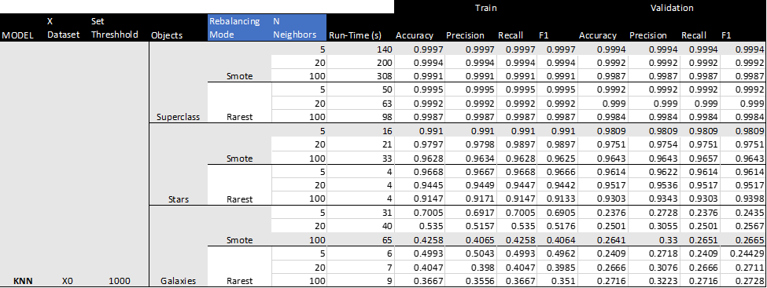
Classification Experiments
Number of hyperparameters tuned ranged from 2 to 6
Studied the impact of data augmentation by using a ‘rebalancing mode’ hyperparameter
Measured run-time performance as well as usual predictive performance metrics
Focused on F1 score for non-balanced validation and test sets
Notes:
Our primary interest was classification of galaxy morphology since it’s the toughest, so for that we tried the classification models.
Hyperparameters were systematically varied to evaluate impact on performance metrics
Number of hyperparameters tuned ranged from 2 to 6, depending on the model.
For tabular data, we varied the rebalancing mode (undersampling vs. oversampling) as a customized hyperparameter for all models to see the impact of data augmentation on training
In additional to the usual predictive performance, we measured run-time performance
Since our validation and tests sets weren’t rebalanced, we judged model performance by F1 score
Now Daelyn will talk about our Image Classification models.

Slide 11
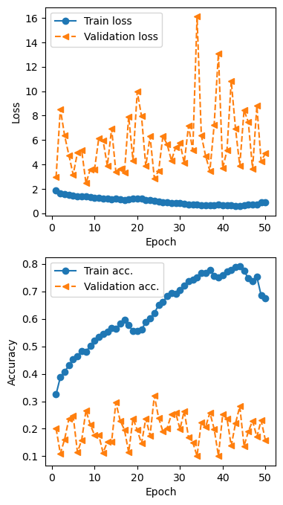
Image Classification: Baseline
FFNN used as baseline for subclassification
Comprised of 4 dense layers that feed into each other, followed by batch normalization
At the end is a single dense layer with SoftMax activation.
Hidden layers used Relu activation
This model had the lowest predictive performance
Notes:
Through the evaluation of our image classification, we first tested a feed forward neural network to serve as a baseline.
All the images were immediately flattened for the feed forward model, then fed through 4 dense layers, each followed by batch normalization, into a single dense slayer with softmax activation.
This model struggled on the image dataset in validation, rarely jumping above 30% accuracy, and became overfit. It does not appear that it was able to recognize most of the complex differences between galaxies classes.

Slide 12
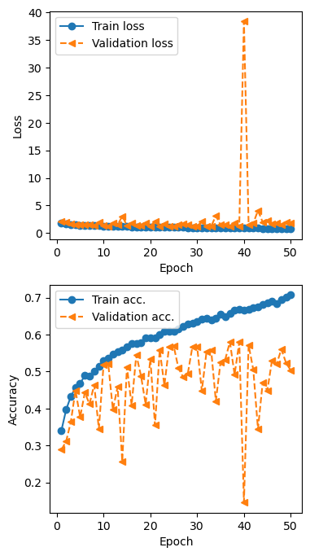
Image Classification: CNN
Best galaxy subclassification model:
Begins with a layer that randomly rotates the image
Followed by 3 series of convolutional layers.
Each series is comprised of a conv2D, a MaxPool2D, and a batch normalization
Fed directly into the next series, until they are flattened after the third convolution.
After flattening, they go through 2 dense layers, each followed by batch normalization. Finally, feed into the final SoftMax layer
Notes:
The convolutional neural network that we trained ended up becoming the best model in terms of performance, regularly jumping to mid 50% range for accuracy.
The model takes images and firsts randomly rotates them to help with overfitting. Images then go through several series of convolutional layers, max pooling, and batch normalization. Images are then flattened and fed through dense layers until reaching softmax activation for classification.

Slide 13
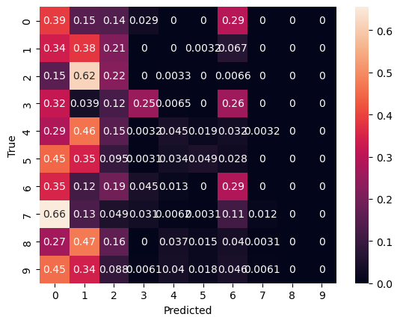
Model Summaries - FFNN
Feed Forward Neural Network
_________________________________________________________________
Layer (type) Output Shape Param #
=================================================================
flatten (Flatten) (None, 150528) 0
fc_1 (Dense) (None, 256) 38535424
batch_normalization (Batch (None, 256) 1024
Normalization)
fc_2 (Dense) (None, 512) 131584
batch_normalization_1 (Bat (None, 512) 2048
chNormalization)
fc_3 (Dense) (None, 256) 131328
batch_normalization_2 (Bat (None, 256) 1024
chNormalization)
fc_4 (Dense) (None, 128) 32896
batch_normalization_3 (Bat (None, 128) 512
chNormalization)
fc_5 (Dense) (None, 10) 1290
=================================================================
Total params: 38837130 (148.15 MB)
Trainable params: 38834826 (148.14 MB)
Non-trainable params: 2304 (9.00 KB)
_________________________________________________________________
Notes:
As you can see in the confusion matrix on the right, the feed forward model tended to only classify as the first few classes instead of recognizing patterns in the more similar classes.
On the left is the model summary.

Slide 14
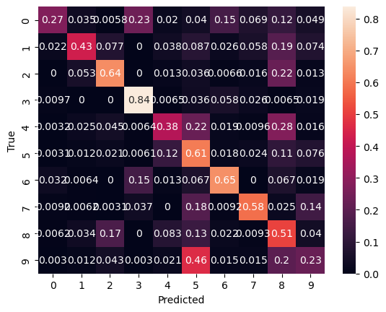
Model Summaries - CNN
Convolutional Neural Network
_________________________________________________________________
Layer (type) Output Shape Param #
=================================================================
rot (RandomRotation) (None, 224, 224, 3) 0
conv_1 (Conv2D) (None, 112, 112, 32) 896
pool_1 (MaxPooling2D) (None, 56, 56, 32) 0
batch_normalization_4 (Bat (None, 56, 56, 32) 128
chNormalization)
conv_2 (Conv2D) (None, 56, 56, 64) 51264
pool_2 (MaxPooling2D) (None, 28, 28, 64) 0
batch_normalization_5 (Bat (None, 28, 28, 64) 256
chNormalization)
conv_3 (Conv2D) (None, 28, 28, 128) 204928
pool_3 (MaxPooling2D) (None, 14, 14, 128) 0
batch_normalization_6 (Bat (None, 14, 14, 128) 512
chNormalization)
flatten_1 (Flatten) (None, 25088) 0
fc_1 (Dense) (None, 2048) 51382272
batch_normalization_7 (Bat (None, 2048) 8192
chNormalization)
fc_2 (Dense) (None, 1024) 2098176
batch_normalization_8 (Bat (None, 1024) 4096
chNormalization)
fc_3 (Dense) (None, 10) 10250
=================================================================
Total params: 53760970 (205.08 MB)
Trainable params: 53754378 (205.06 MB)
Non-trainable params: 6592 (25.75 KB)
_________________________________________________________________
Notes:
As you can see on the CNNs confusion matrix, it was able to much better differentiate compared to the feed forward, but there are still many similar classes which throw off the model.
On the right is the model summary for those interested.

Slide 15
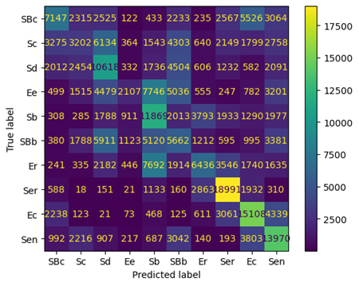
Tabular Model Summary - FFNN
Best tabular galaxy subclassification model:
Training data augmented using SMOTE
2 hidden dense layers
Relu activations
Learning Rate of 0.1
Overall Accuracy 0.37
Notes:
Just a quick note here, we can see by the confusion matrix here that the tabular feed forward model for galaxies did not experience the same issue the image classification model did, and was able to differentiate classes, if still doing a poor job overall.

Slide 16
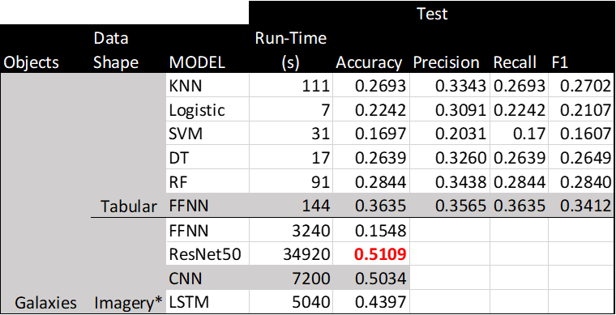
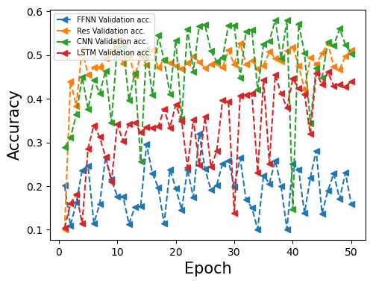
Conclusion
Tabular data for superclass and star sub classes performed incredibly well
Tabular data did not perform well on the geometric properties of the galaxies
Of all models for image classification, CNN performed the best, but inconsistently.
Resnet was incredibly performance heavy compared to all other models
Image recognition may not be the best application of FFNN and LSTM models
We were not able to reach the target of 80% accuracy we set earlier in the semester
Notes:
In conclusion, for the tabular data we saw incredible performance on the superclass and star models, with the majority reaching over 99% validation accuracy.
The galaxy classification was more difficult on the tabular dataset, as it had to understand geometric properties.
For image classification, the CNN performed best with issues regarding consistency on the validation. While the resnet had much more consistent performance thanks to the transferred model weights, it was significantly more performance heavy, taking 5 times the time of the CNN.
In terms of the Feed Forward and Long Short Term Memory Models, they may not be as suited to individual image recognition, especially when there is not a correlation between images.
Tragically, we were not able to reach our original target of 80% accuracy for galaxy classification, as the task was much more difficult than we had anticipated.

Slide 17
Questions?

Slide 18
Backup Slides

Slide 19
Computing Environments
PC 1
Intel Core i7-7660U CPU
16GB DDR3 RAM
PC 2
AMD Ryzen 7 7800X3D CPU
32GB DDR5 RAM
Virtual Environment
Python 3.10
Conda Package Manager
Prototyping in Jupyter Notebooks
Key libraries: pandas, numpy, matplotlib, seaborn, sklearn, tensorflow, keras

Slide 20
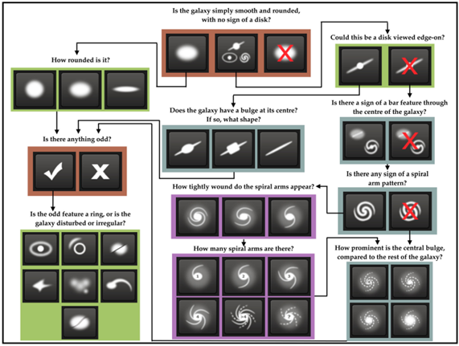
Galaxy Zoo 2 Decision Tree

Slide 21
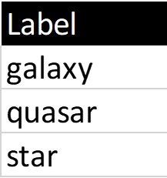
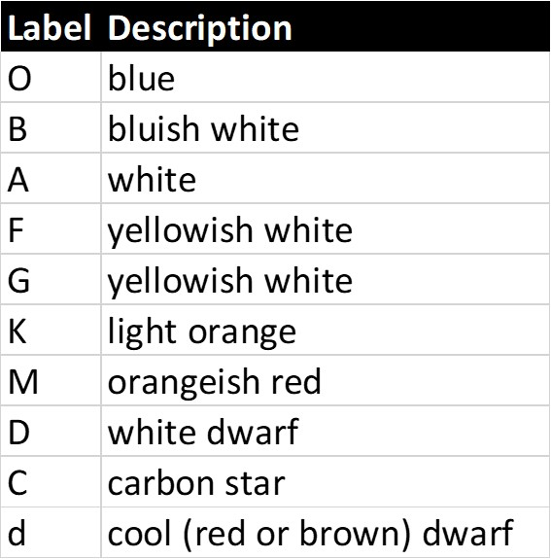
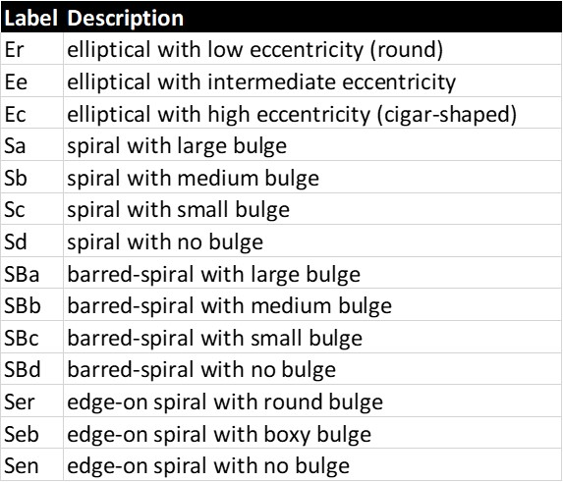
Simplified Labels for each Classification Task
Superclass
Stars
Galaxies

Slide 22
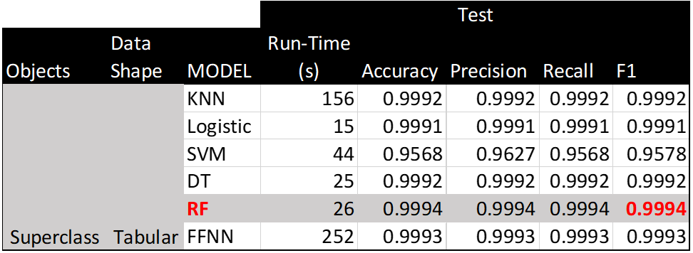
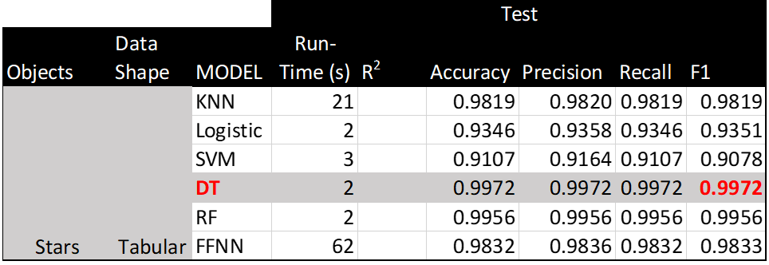
Test metrics of tuned models for superclass & star

Slide 23
Superclass Classification: Baseline
RFC used as baseline for superclass classification:
Hyperparameters used during training:
Rebalancing Mode
Bootstrap sampling
Number of estimators
Oversampling led to better results at the cost of 10x run time
10 estimators proved to be sufficient for optimal performance

Slide 24
Superclass Classification: Best Model
FFNN was best model for superclass classification
Used Adam optimizer with 2 hidden layers
First hidden layer had 512 neurons, second with 128 neurons
69,123 trainable parameters for 5-feature dataset, 70,917 parameters for 8 feature dataset
2048 batch size, 5 epochs
Results with best hyperparameters (Validation F-1):
Superclass: ~100%
Stellar subclass: ~98%
Galaxy subclass: ~28%.

Slide 25
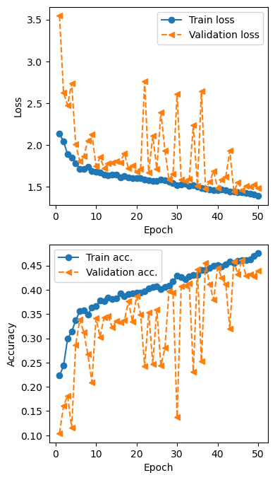
Model Summaries - LSTM
Long Short Term Memory Model
_________________________________________________________________
Layer (type) Output Shape Param #
=================================================================
reshape (Reshape) (None, 1, 224, 224, 3) 0
rot (TimeDistributed) (None, 1, 224, 224, 3) 0
c1 (TimeDistributed) (None, 1, 112, 112, 32) 896
p1 (TimeDistributed) (None, 1, 56, 56, 32) 0
bn1 (TimeDistributed) (None, 1, 56, 56, 32) 128
c2 (TimeDistributed) (None, 1, 56, 56, 64) 51264
p2 (TimeDistributed) (None, 1, 28, 28, 64) 0
bn2 (TimeDistributed) (None, 1, 28, 28, 64) 256
c3 (TimeDistributed) (None, 1, 28, 28, 128) 204928
p3 (TimeDistributed) (None, 1, 14, 14, 128) 0
bn3 (TimeDistributed) (None, 1, 14, 14, 128) 512
flat (TimeDistributed) (None, 1, 25088) 0
lstm (LSTM) (None, 256) 25953280
fc_2 (Dense) (None, 128) 32896
batch_normalization_12 (Ba (None, 128) 512
tchNormalization)
dense (Dense) (None, 10) 1290
=================================================================
Total params: 26245962 (100.12 MB)
Trainable params: 26245258 (100.12 MB)
Non-trainable params: 704 (2.75 KB)
_________________________________________________________________

